Slide 1



Python 3 Beginner
Chapter 00
Previously, on Python 3 Beginner…
release 1.0.0
37/39 Avenue Ledru Rollin – CS 11237 – 75750 PARIS CEDEX 12 - info@valnaos.com – www.valnaos.com Tél : 01 86 95 20 48

Slide 2

What we saw last time
Python 3 Beginner
Learning more about list to handle ordered sequences of objects
The power and the danger of mutability
Using tuple as an immutable ordered sequence
The set type as an unordered list of distinct elements
Performing set arithmetic with set operators
The dict type to map values and structure data
Powerful sequence tools in Python:
List comprehensions to quickly build lists for iterables
Starred expressions to unpack iterables
any/all to perform checks on all items of an iterable

Slide 3

Cloud Technology Associate
Copyright © 2018 | 9
Q&A
37/39 Avenue Ledru Rollin – CS 11237 – 75750 PARIS CEDEX 12 - info@valnaos.com – www.valnaos.com Tél : 01 86 95 20 48

Slide 4

Where? Who?
Python 3 Beginner
Class Material
GitHub: https://github.com/cstar-industries/python-3-beginner
Instructor
Charles Francoise <charles@cstar.io>

Slide 5

Session Objectives
Python 3 Beginner
At the end of this session, you will be able to:
Define your own functions in Python
Call a function and use the result
Know the arcanes of argument passing
Understand the scope of variables in functions
Quickly build anonymous functions using lambda expressions
Understand the basics of functional programming
Write generator functions to use in your own for iterations
Handle errors in your own code

Slide 6
Session Syllabus
Python 3 Beginner
Chapter | Subject | Start | End | Total Time (in hours)
00 | Previously on Python 3 Beginner… | 14:00 | 14:15 | 00:15
01 | Functions: Part I | 14:15 | 15:00 | 00:45
 | Coffee Break | 15:00 | 15:10 | 00:10
02 | Functions: Part II | 15:10 | 15:55 | 00:45
 | Coffee Break | 15:55 | 16:05 | 00:10
03 | Generators and Error Handling | 16:05 | 16:50 | 00:45
 | Coffee Break | 16:50 | 17:00 | 00:10
 | Workshop | 17:00 | 18:00 | 01:00
 | Total |  |  | 04:00

Slide 7
But first...
Python 3 Beginner
Use reversed to iterate a sequence in reverse
for p in reversed([2, 3, 5, 7, 11, 13]):
print(p, end=' ')
13 11 7 5 3 2
sorted returns a list sorted from the items in an iterable
sorted([0, 3, 5, 8, 1, 4, 2, 9, 6, 7])
[0, 1, 2, 3, 4, 5, 6, 7, 8, 9]
sorted([0, 3, 5, 8, 1, 4, 2, 9, 6, 7], reverse=True)
[9, 8, 7, 6, 5, 4, 3, 2, 1, 0]

Slide 8
But first...
Python 3 Beginner
list has methods to sort or reverse in place
l = [1, 6, 3, 9, 7]
l.sort()
print(l)
[1, 3, 6, 7, 9]
l.reverse()
print(l)
[9, 7, 6, 3, 1]

Slide 9
Python 3 Beginner
Chapter 01
Functions: Part I
release 1.0.0
37/39 Avenue Ledru Rollin – CS 11237 – 75750 PARIS CEDEX 12 - info@valnaos.com – www.valnaos.com Tél : 01 86 95 20 48

Slide 10
ROT encryption-decryption
Python 3 Beginner
plaintext = 'Meet me in the park at midnight'
ciphertext = ''
plaintext = plaintext.lower()
for c in plaintext:
if 'a' <= c <= 'z':
ciphertext += chr(((ord(c) - ord('a') + 13) % 26) + ord('a'))
else:
ciphertext += c
print(ciphertext)

Slide 11
ROT encryption-decryption
Python 3 Beginner
plaintext_0 = 'Meet me in the park at midnight'
ciphertext_0 = ''
plaintext_0 = plaintext_0.lower()
for c in plaintext_0:
if 'a' <= c <= 'z':
ciphertext_0 += chr(((ord(c) - ord('a') + 13) % 26) + ord('a'))
else:
ciphertext_0 += c
print(ciphertext_0)
plaintext_1 = 'Keep a close eye on Manny'
ciphertext_1 = ''
plaintext_1 = plaintext_1.lower()
for c in plaintext_1:
if 'a' <= c <= 'z':
ciphertext_1 += chr(((ord(c) - ord('a') + 5) % 26) + ord('a'))
else:
ciphertext_1 += c
print(ciphertext_1)

Slide 12
ROT encryption-decryption
Python 3 Beginner
plaintext_0 = 'Meet me in the park at midnight'
ciphertext_0 = ''
plaintext_0 = plaintext_0.lower()
for c in plaintext_0:
if 'a' <= c <= 'z':
ciphertext_0 += chr(((ord(c) - ord('a') + 13) % 26) + ord('a'))
else:
ciphertext_0 += c
print(ciphertext_0)
plaintext_1 = 'Keep a close eye on Manny'
ciphertext_1 = ''
plaintext_1 = plaintext_1.lower()
for c in plaintext_1:
if 'a' <= c <= 'z':
ciphertext_1 += chr(((ord(c) - ord('a') + 5) % 26) + ord('a'))
else:
ciphertext_1 += c
print(ciphertext_1)
ciphertext_2 = 'we qmqo! eh y mybb jqkdj oek q iusedt jycu.'
plaintext_2 = ''
ciphertext_2 = ciphertext_2.lower()
for c in ciphertext_2:
if 'a' <= c <= 'z':
plaintext_2 += chr(((ord(c) - ord('a') - 16) % 26) + ord('a'))
else:
plaintext_2 += c
print(plaintext_2)
😱

Slide 13
ROT encryption-decryption
Python 3 Beginner
plaintext_0 = 'Meet me in the park at midnight'
ciphertext_0 = ''
plaintext_0 = plaintext_0.lower()
for c in plaintext_0:
if 'a' <= c <= 'z':
ciphertext_0 += chr(((ord(c) - ord('a') + 13) % 26) + ord('a'))
else:
ciphertext_0 += c
print(ciphertext_0)
plaintext_1 = 'Keep a close eye on Manny'
ciphertext_1 = ''
plaintext_1 = plaintext_1.lower()
for c in plaintext_1:
if 'a' <= c <= 'z':
ciphertext_1 += chr(((ord(c) - ord('a') + 5) % 26) + ord('a'))
else:
ciphertext_1 += c
print(ciphertext_1)
ciphertext_2 = 'we qmqo! eh y mybb jqkdj oek q iusedt jycu.'
plaintext_2 = ''
ciphertext_2 = ciphertext_2.lower()
for c in ciphertext_2:
if 'a' <= c <= 'z':
plaintext_2 += chr(((ord(c) - ord('a') - 16) % 26) + ord('a'))
else:
plaintext_2 += c
print(plaintext_2)
plaintext/ciphertext
key
encrypt/decrypt

Slide 14
Defining a function
Python 3 Beginner
def rot(input_text, key, encrypt):
if not encrypt:
key = -key
output_text = ''
input_text = input_text.lower()
for c in input_text:
if 'a' <= c <= 'z':
output_text += chr(((ord(c) - ord('a') + key) % 26) + ord('a'))
else:
output_text += c
print(output_text)

Slide 15
ROT encryption-decryption
Python 3 Beginner
def rot(input_text, key, encrypt):
if not encrypt:
key = -key
output_text = ''
input_text = input_text.lower()
for c in input_text:
if 'a' <= c <= 'z':
output_text += chr(((ord(c) - ord('a') + key) % 26) + ord('a'))
else:
output_text += c
print(ciphertext)
plaintext_0 = 'Meet me in the park at midnight'
rot(plaintext_0, 13, True)
plaintext_1 = 'Keep a close eye on Manny'
rot(plaintext_1, 5, True)
ciphertext_2 = 'we qmqo! eh y mybb jqkdj oek q iusedt jycu.'
rot(ciphertext_2, 16, False)

Slide 16
Anatomy of a function declaration
Python 3 Beginner
def rot(input_text, key, encrypt):
if not encrypt:
key = -key
...

Slide 17
Anatomy of a function declaration
Python 3 Beginner
def rot(input_text, key, encrypt):
if not encrypt:
key = -key
...
Function declaration keyword

Slide 18
Anatomy of a function declaration
Python 3 Beginner
def rot(input_text, key, encrypt):
if not encrypt:
key = -key
...
Function name

Slide 19
Anatomy of a function declaration
Python 3 Beginner
def rot(input_text, key, encrypt):
if not encrypt:
key = -key
...
Function arguments

Slide 20
Anatomy of a function declaration
Python 3 Beginner
def rot(input_text, key, encrypt):
if not encrypt:
key = -key
...
Function body

Slide 21
Calling a function
Python 3 Beginner
Call a function using its name, and arguments between parentheses
rot(plaintext_0, 13, True)
zrrg zr va gur cnex ng zvqavtug
Arguments can be any expression
Arguments can be passed by keyword
rot(encrypt=True, input_text=plaintext_0, key=13)
zrrg zr va gur cnex ng zvqavtug

Slide 22
Let’s write some code!
Python 3 Beginner
def say(text):
print('I say:', text)
say('Hello')
I say: Hello
Notes:
* The `print` function outputs whatever we tell it to

Slide 23
Conceptual view of a function
Python 3 Beginner
rot
According to encrypt
Encrypt or decrypt input_text with the ROT encryption scheme
Using key as key
And output it
input_text
key
encrypt

Slide 24
Conceptual view of a function
Python 3 Beginner
.
.
.
arguments
.
.
.
function
Do something using the arguments

Slide 25
Functions return a value
Python 3 Beginner
Function calls are expressions that evaluate to a value
Functions that don't return a value return None
print(rot(plaintext_0, 13, True))
zrrg zr va gur cnex ng zvqavtug
None
👀 Note that our call to rot() was used as argument in our call to print()

Slide 26
Functions return a value
Python 3 Beginner
Function calls are expressions that evaluate to a value
Functions that don't return a value return None
print(rot(plaintext_0, 13, True))
zrrg zr va gur cnex ng zvqavtug
None
👀 Note that our call to rot() was used as argument in our call to print()

Slide 27
Functions return a value
Python 3 Beginner
Returning the value instead of printing it
def rot(input_text, key, encrypt):
if not encrypt:
key = -key
output_text = ''
input_text = input_text.lower()
for c in input_text:
if 'a' <= c <= 'z':
output_text += chr(((ord(c) - ord('a') + key) % 26) + ord('a'))
else:
output_text += c
return output_text

Slide 28
Functions return a value
Python 3 Beginner
Assign the return value of a function as a usual expression
ciphertext_0 = rot(plaintext_0, 13, True)
No output

Slide 29
Conceptual view of a function
Python 3 Beginner
.
.
.
arguments
.
.
.
function
Do something using the arguments
return

Slide 30
Let’s write some code!
Python 3 Beginner
def pretty_format(text, delimiters):
s = f'{delimiters[0]}{text}{delimiters[1]}'
return s, len(s)
s, l = pretty_format('Hello World', delimiters=['<== ', ' ==>'])
print(s)
print(f'Length of s: {l}')
<== Hello World ==>
Length of s: 19
Notes:
* The `print` function outputs whatever we tell it to

Slide 31
Default arguments
Python 3 Beginner
Use sensible default values for arguments in function declaration
def rot(input_text, key=13, encrypt=True):
if not encrypt:
key = -key
output_text = ''
input_text = input_text.lower()
for c in input_text:
if 'a' <= c <= 'z':
output_text += chr(((ord(c) - ord('a') + key) % 26) + ord('a'))
else:
output_text += c
return output_text

Slide 32
Default arguments
Python 3 Beginner
Make function calls easier to read in the most common case
rot(plaintext_0)
'zrrg zr va gur cnex ng zvqavtug'
Extend function behaviour without changing every callpoint
def rot(input_text, key=13, encrypt=True, print_it=False):
...
if print_it:
print(output_text)
return output_text
ciphertext_0 = rot(plaintext_0, print_it=True)
zrrg zr va gur cnex ng zvqavtug

Slide 33
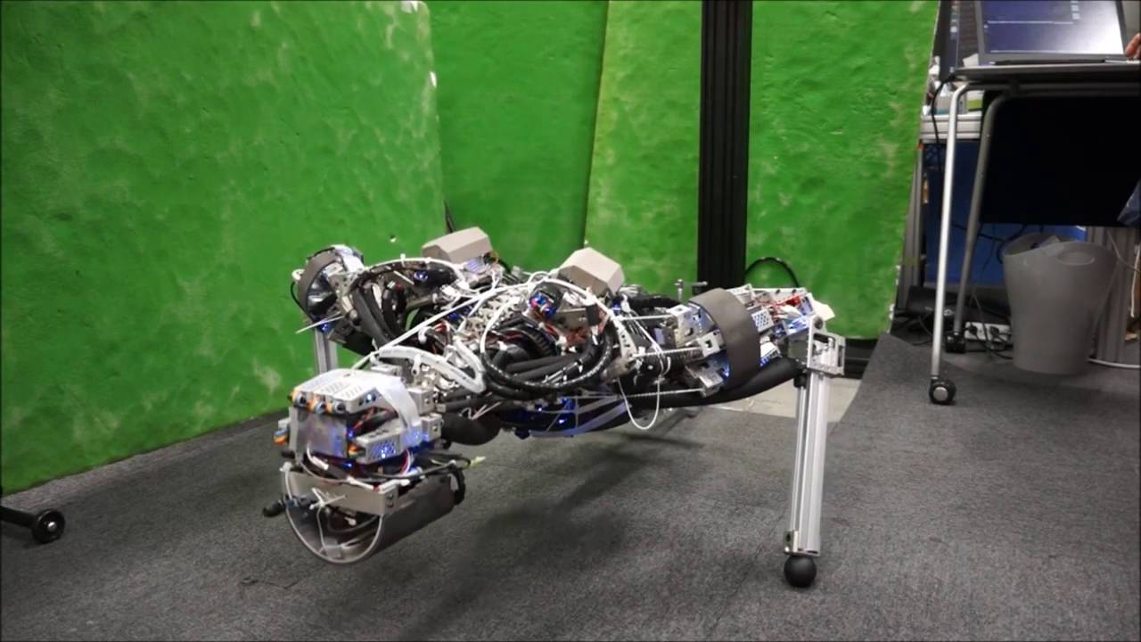
Workout Time!
Python 3 Beginner
Notes:
https://github.com/cstar-industries/python-3-beginner/blob/master/001-First-Steps/First%20Steps%20-%20Chap%2001%20-%20Exercises.ipynb

Slide 34
Chapter Summary
Python 3 Beginner
In this chapter, we learned how to:
Define our own functions
Call a function
Return a value from a function
Use default arguments to simplify function calls in the most current cases

Slide 35
Python 3 Beginner
Chapter 02
Functions: Part II
release 1.0.0
37/39 Avenue Ledru Rollin – CS 11237 – 75750 PARIS CEDEX 12 - info@valnaos.com – www.valnaos.com Tél : 01 86 95 20 48

Slide 36
Variable arguments
Python 3 Beginner
print takes a variable number of arguments
print()
print('Hello')
print('Hello', 1, 'World!', [0, 1, 2])
Use *args to denote a variable number of arguments
args is a list in your function body
Only positional arguments (no keywords)
def multiple_sqrt(*args):
return [math.sqrt(n) for n in args]
multiple_sqrt(0, 1, 4, 9, 16)
[0.0, 1.0, 2.0, 3.0, 4.0]

Slide 37
Variable keyword arguments
Python 3 Beginner
Use **kwargs for variable keyword arguments
kwargs is a dict in your function body
def print_items_with_title(**kwargs):
for k, v in kwargs.items():
print(f'{k.title()}: {v}')
print_items_with_title(greeting='Hello World!', count=12, r=None)
Greeting: Hello World!
Count: 12
R: None

Slide 38
Variable arguments
Python 3 Beginner
You can mix *args and **kwargs in the same function declaration
def func(*args, **kwargs):
# Do stuff with args and kwargs
Variable positional arguments must always come before keyword arguments
func(0, 1, 2, hello='world')

Slide 39
Unpacking a sequence to arguments
Python 3 Beginner
Use * to unpack a list as function arguments
rot_args = ['Hello World', 1, True]
rot(*rot_args)
'ifmmp xpsme'
Use ** to unpack a dict as function keyword arguments
rot_args = {'encrypt': False, 'key': 1, 'input_text': 'ifmmp xpsme'}
rot(**rot_args)
'hello world'

Slide 40
Functions and variable scope
Python 3 Beginner
Variables created inside a function body only exist inside the function (while it is running)
def coin_toss():
rnd = random()
if rnd < 0.5:
return 'Heads'
else:
return 'Tails'
coin_toss()
'Heads'
print(rnd)
NameError: name 'rnd' is not defined

Slide 41
Functions and variable scope
Python 3 Beginner
Arguments are local to function
def yell(text):
text = text.upper()
print(text + '!')
s = 'hello'
yell(s)
HELLO!
print(s)
hello
👀Note that s was not modified by text = text.upper()

Slide 42
Functions and variable scope
Python 3 Beginner
Variables outside the function can be referenced
def yell():
text = s.upper()
print(text + '!')
s = 'hello'
yell()
HELLO!

Slide 43
Functions and variable scope
Python 3 Beginner
...But not reassigned
def yell():
s = s.upper()
print(s + '!')
s = 'hello'
yell()
UnboundLocalError: local variable 's' referenced before assignment

Slide 44
Functions and variable scope
Python 3 Beginner
Use global to assign to a variable outside the function
def yell():
global s
s = s.upper()
print(s + '!')
s = 'hello'
yell()
HELLO!
⚠️ But watch out for side-effects!
print(s)
HELLO

Slide 45
Functions and variable scope
Python 3 Beginner
Variable names are local, but their content is the same object
⚠️ Watch out for mutability
def add_a_fib(fibs):
fibs.append(fibs[-1] + fibs[-2])
print(fibs[-1])
return fibs
f = [0, 1, 1, 2]
print(add_a_fib(f))
print(f)
3
[0, 1, 1, 2, 3]
[0, 1, 1, 2, 3]

Slide 46
Conceptual view of a function
Python 3 Beginner
Old state
.
.
.
arguments
.
.
.
function
Do something using the arguments
return
New state

Slide 47
Let’s write some code!
Python 3 Beginner
def f():
a = []
print(a)
a += [0, 1, 2]
print(a)
f()
print(a)
[]
[0, 1, 2]
NameError: name 'a' is not defined

Slide 48
Functional programming primer
Python 3 Beginner
Functions defined with def are just like variables
def say_hello():
print('Hello World!')
type(say_hello)
function
A function can be assigned to another variable
f = say_hello
f()
Hello World!

Slide 49
Functional programming primer
Python 3 Beginner
A function can be deleted
del say_hello
say_hello()
NameError: name 'say_hello' is not defined
A function can be added to a container
d = {'obj': 12, 'fun': f}
print(d)
{'obj': 12, 'fun': <function say_hello at 0x11016bd40>}

Slide 50
Functional programming primer
Python 3 Beginner
A function can be passed as an argument
def do_n_times(fn, n):
for _ in range(n):
fn()
do_n_times(f, 3)
Hello World!
Hello World!
Hello World!

Slide 51
Functional programming primer
Python 3 Beginner
Lambda expressions create anonymous functions from an expression
def do_range(fn, n):
for i in range(n):
print(fn(i))
do_range(lambda x: x*x, 5)
0
1
4
9
16

Slide 52
Let’s write some code!
Python 3 Beginner
def f():
a = []
print(a)
a += [0, 1, 2]
print(a)
f()
print(a)
[]
[0, 1, 2]
NameError: name 'a' is not defined

Slide 53
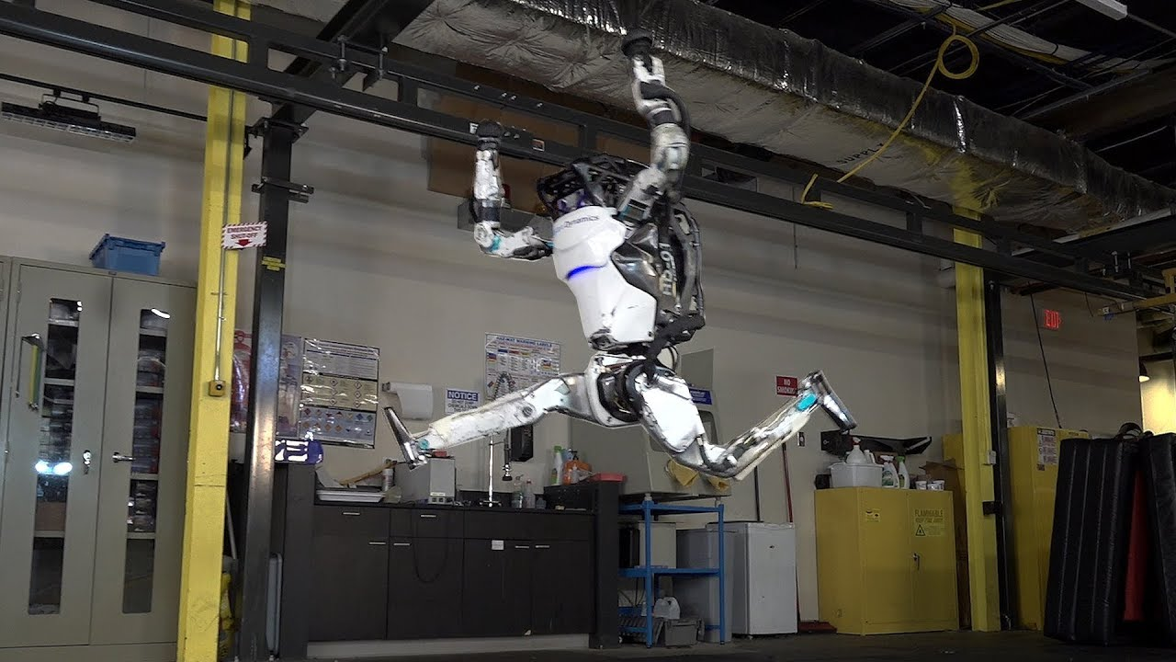
Workout Time!
Python 3 Beginner
Notes:
https://github.com/cstar-industries/python-3-beginner/blob/master/001-First-Steps/First%20Steps%20-%20Chap%2002%20-%20Exercises.ipynb

Slide 54
Chapter Summary
Python 3 Beginner
In this chapter, we learned how about:
Keyword arguments to make function calls more explicit
Variable argument lists (*args, **kwargs)
Unpacking a sequence type into arguments in a function call
Variable scope inside and outside a function
Mutability inside a function

Slide 55
Python 3 Beginner
Chapter 03
Generators and Error handling
release 1.0.0
37/39 Avenue Ledru Rollin – CS 11237 – 75750 PARIS CEDEX 12 - info@valnaos.com – www.valnaos.com Tél : 01 86 95 20 48

Slide 56
Generator functions
Python 3 Beginner
You can build your own functions to use in a for iteration
def fib_range(n):
if n > 0:
yield 0
if n > 1:
yield 1
f0 = 0
f1 = 1
for _ in range(n - 2):
f = f0 + f1
yield f
f0 = f1
f1 = f

Slide 57
Generator functions
Python 3 Beginner
Each time the iteration loops, the function runs until the next yield statement
for f in fib_range(8):
print(f)
0
1
1
2
3
5
8
13

Slide 58
Iterators
Python 3 Beginner
You can also progress on an iterator using the built-in next() function
z = zip(firstname, lastnames, dobs)
first, last, dob = next(z)
while first != 'Guido' and last != 'van Rossum':
first, last, dob = next(z)
print(f'{first} {last} was born on {dob}')
print('We found Guido!')
Dennis Ritchie was born on September 9, 1941
Ken Thompson was born on February 4, 1943
Niklaus Wirth was born on February 15, 1934
We found Guido!

Slide 59
Errors
Python 3 Beginner
You've already seen some errors
print(l)
NameError: name 'l' is not defined
l = (0, 1, 2)
l.pop()
AttributeError: 'tuple' object has no attribute 'pop'
l[0] = 'zero'
TypeError: 'tuple' object does not support item assignment

Slide 60
Errors
Python 3 Beginner
Errors "bubble up" function calls
def print_sqrt(n):
print(f'The square root of {n} is {math.sqrt(n)}')
def print_rnd_sqrt():
print_sqrt(random() – 0.5)
print_rnd_sqrt()
Traceback (most recent call last):
File "<stdin>", line 1, in <module>
File "<stdin>", line 2, in print_rnd_sqrt
File "<stdin>", line 2, in print_sqrt
ValueError: math domain error

Slide 61
Catching Errors
Python 3 Beginner
Errors "bubble up" function calls
def print_sqrt(n):
try:
print(f'The square root of {n} is {math.sqrt(n)}')
except:
print(f'Could not compute the square root of {n}')
print_rnd_sqrt()
Could not compute the square root of -0.3587785826661578
Open a try block to capture errors in unsafe code
Handle errors in an except block

Slide 62
Ignoring Errors
Python 3 Beginner
Use the pass statement to ignore errors in except handlers
def list_sqrt(in_list):
out_list = []
for n in in_list:
try:
out_list.append(math.sqrt(n))
except:
pass
return out_list
list_sqrt([2, -1, 16, 'zero', None, 256])
[1.4142135623730951, 4.0, 16.0]
The pass statement can be used anywhere, when a block should do nothing

Slide 63
Errors should not be (silently) ignored!
Python 3 Beginner
Use the pass statement to ignore errors in except handlers
def list_sqrt(in_list):
out_list = []
for n in in_list:
try:
out_list.append(math.sqrt(n))
except:
pass
return out_list
list_sqrt([2, -1, 16, 'zero', None, 256])
Never do this, actually! 🚨
[1.4142135623730951, 4.0, 16.0]
The pass statement can be used anywhere, when a block should do nothing

Slide 64
Catching specific errors
Python 3 Beginner
Specify the type of error you wish to catch after except
x = None
while x is None:
try:
x = int(input('Enter an integer number: '))
except ValueError:
print(f'Could not parse integer.')
Enter an integer number: fe
Could not parse integer.
Enter an integer number: ^C
Traceback (most recent call last):
File "<stdin>", line 3, in <module>
KeyboardInterrupt

Slide 65
Catching specific errors
Python 3 Beginner
Specify the type of error you wish to catch after except
x = None
while x is None:
try:
x = int(input('Enter an integer number: '))
except ValueError:
print(f'Could not parse integer.')
Enter an integer number: fe
Could not parse integer.
Enter an integer number: ^C
Traceback (most recent call last):
File "<stdin>", line 3, in <module>
KeyboardInterrupt

Slide 66
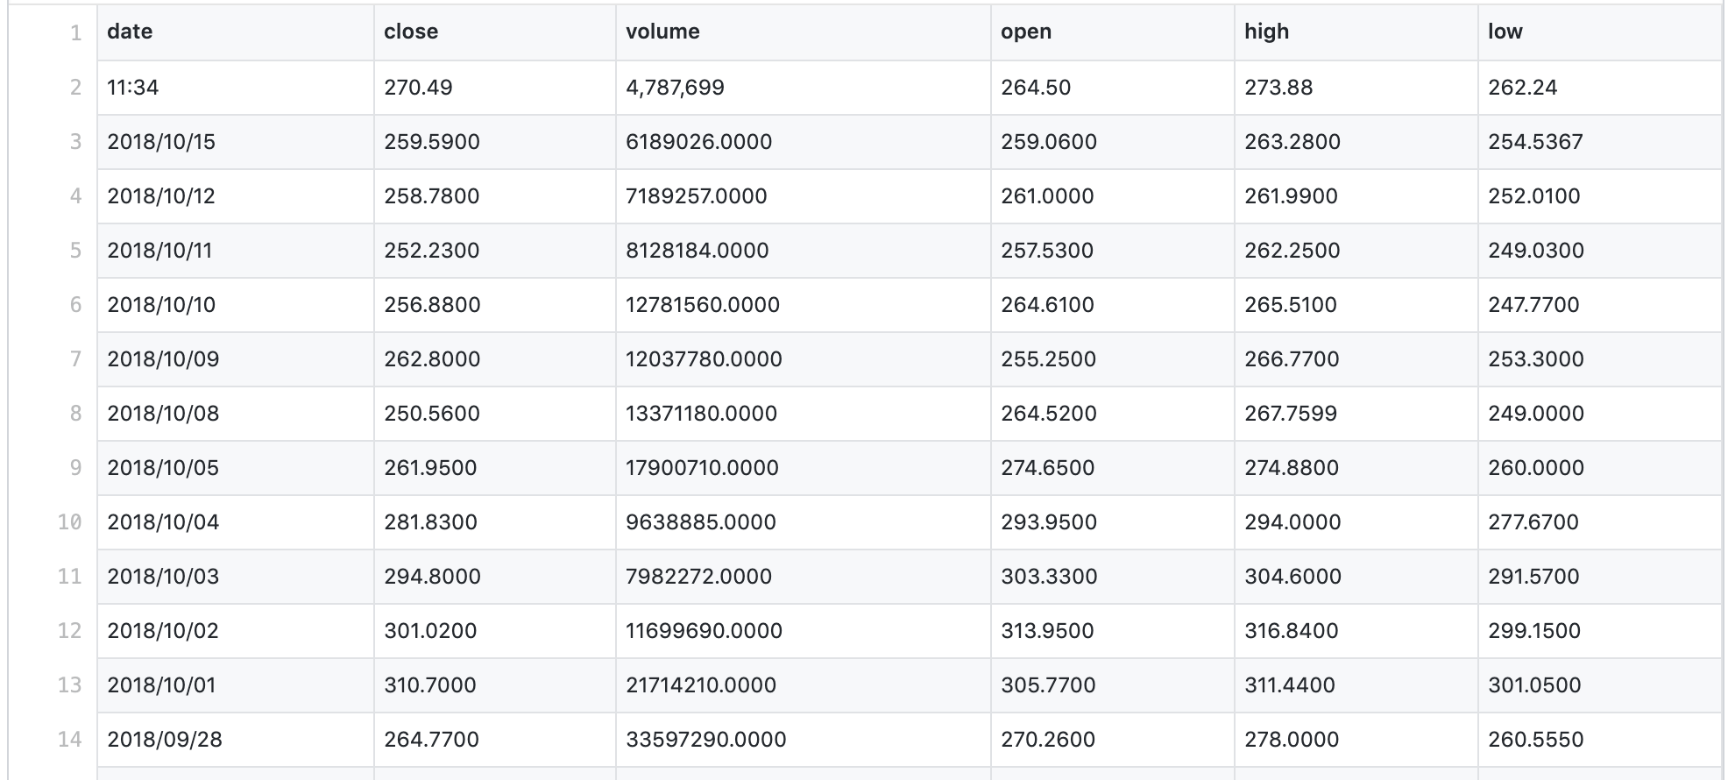
Deeper into error handling
Python 3 Beginner
For the following slides we will be trying to read a csv containing stock prices with the following format

Slide 67
Deeper into error handling
Python 3 Beginner
This is the program we wrote
def read_csv(path):
rows = []
f = open(path)
s = f.read().splitlines()
for row in s:
row = row.split(',')
date = datetime.strptime(row[0], '%Y/%m/%d')
price = float(row[1])
rows.append((date, price))
f.close()
return rows
This program has many possible errors. Let's dig deeper into it!

Slide 68
Deeper into error handling
Python 3 Beginner
def read_csv(path):
rows = []
f = open(path)
s = f.read().splitlines()
for row in s:
row = row.split(',')
date = datetime.strptime(row[0], '%Y/%m/%d')
price = float(row[1])
rows.append((date, price))
f.close()
return rows
Possible errors with the file:
File may not exist
User may not have read rights to the file
Hard drive may be unable to read
...

Slide 69
Deeper into error handling
Python 3 Beginner
def read_csv(path):
rows = []
f = open(path)
s = f.read().splitlines()
for row in s:
row = row.split(',')
date = datetime.strptime(row[0], '%Y/%m/%d')
price = float(row[1])
rows.append((date, price))
f.close()
return rows
Possible errors reading lines:
row may not have data at indexes 0 or 1
date may not be correctly formatted
price column may not contain a value convertible to float

Slide 70
Deeper into error handling
Python 3 Beginner
Let's handle those errors
def read_csv(path):
rows = []
try:
f = open(path)
s = f.read().splitlines()
for row in s:
row = row.split(',')
date = datetime.strptime(row[0], '%Y/%m/%d')
price = float(row[1])
rows.append((date, price))
f.close()
except OSError as err:
print(f'Failed to open file. {err}')
except ValueError as err:
print(f'Invalid data. {err}')
except:
raise
return rows

Slide 71
Deeper into error handling
Python 3 Beginner
Expected errors are handled accordingly
The error is captured to the err variable and used in the error message
except OSError as err:
print(f'Failed to open file. {err}')
except ValueError as err:
print(f'Invalid data. {err}')
Unexpected errors are raised to the caller
except:
raise

Slide 72
Deeper into error handling
Python 3 Beginner
Use else to handle the case when no errors are caught
def read_csv(path):
...
except OSError as err:
print(f'Failed to open file. {err}')
except ValueError as err:
print(f'Invalid data. {err}')
except:
raise
else:
return rows
return []

Slide 73
Deeper into error handling
Python 3 Beginner
Execute cleanup code regardless of errors with finally
def read_csv(path):
...
except OSError as err:
print(f'Failed to open file. {err}')
except ValueError as err:
print(f'Invalid data. {err}')
except:
raise
else:
return rows
finally:
f.close()
return []

Slide 74
Raising your own errors
Python 3 Beginner
You can raise your own errors in functions, for better control
def do_something_with_an_int(n):
if type(n) != int:
raise TypeError(f'Expected int, got {type(n)}')
if (n % 2) != 0:
raise ValueError(f'{n} can't be divided by 2')
...
Learn more about all the built-in Python errors by reading the documentation

Slide 75
Let’s write some code!
Python 3 Beginner
s = 'Hello World!'
{c: s.count(c) for c in s}
{' ': 1, '!': 1, 'H': 1, 'W': 1, 'd': 1, 'e': 1, 'l': 3, 'o': 2, 'r': 1}

Slide 76
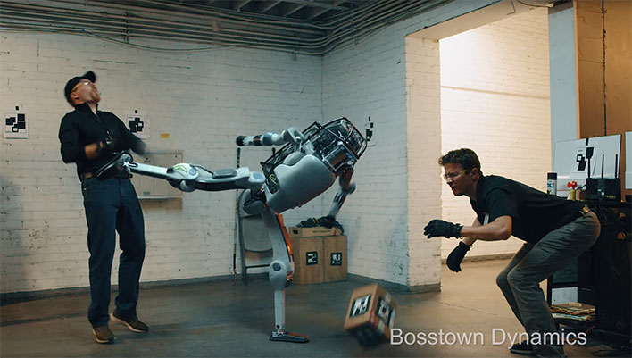
Workout Time!
Python 3 Beginner
Notes:
https://github.com/cstar-industries/python-3-beginner/blob/master/001-First-Steps/First%20Steps%20-%20Chap%2003%20-%20Exercises.ipynb

Slide 77
Chapter Summary
Python 3 Beginner
In this chapter, we learned how about:
Default arguments to simplify function calls in the most current cases
Keyword arguments to make function calls more explicit
Variable argument lists (*args, **kwargs)
Unpacking a sequence type into arguments in a function call
Variable scope inside and outside a function
Mutability inside a function

Slide 78
Cloud Technology Associate
Copyright © 2018 | 9
Q&A
37/39 Avenue Ledru Rollin – CS 11237 – 75750 PARIS CEDEX 12 - info@valnaos.com – www.valnaos.com Tél : 01 86 95 20 48

Slide 79
Workshop
Python 3 Beginner
Notes:
https://github.com/cstar-industries/python-3-beginner/blob/master/001-First-Steps/First%20Steps%20-%20Workshop.ipynb

Slide 80
Thank you for your attention!

